Slide 1
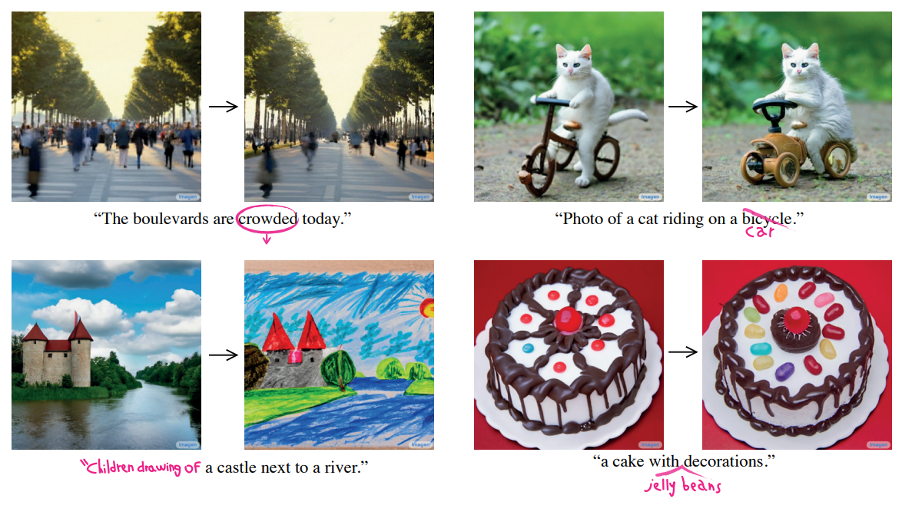
Prompt-to-Prompt Image Editing
with Cross Attention Control

Slide 2
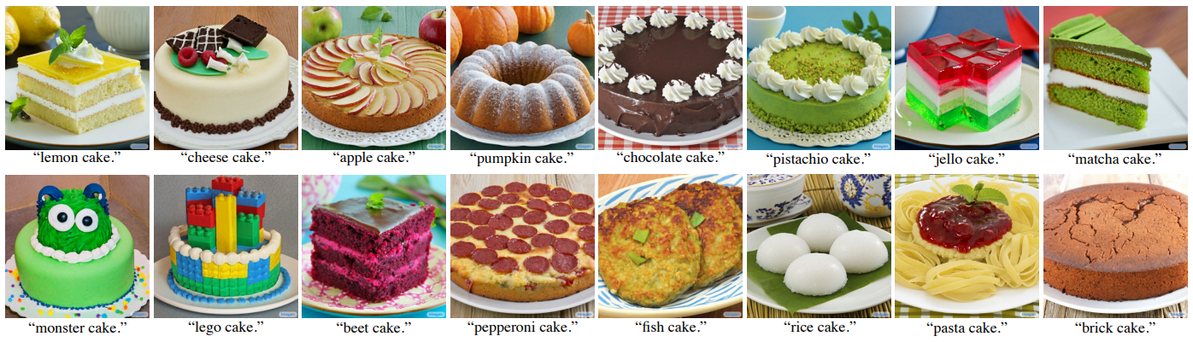
Problem definition
Diffusion + LLM → high quality & reliable for prompt image
But can’t “editing” the image
Ex) slightest change in the textual prompt → completely different output image
→ Goal: Prompt-to-Prompt Editing (not just generate another image)

Slide 3
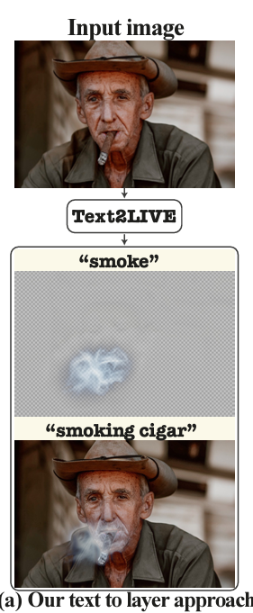
Related work
GAN-based editing: high quality but highly-curated dataset (struggle over large and diverse datasets) → due to GAN’s limitations (?)
Mask + generative models, Text2LIVE (automatically masking?):
can change textures, But can’t modify complex structures
(because they cover the image with generated image)
Diffusion-based models: good performance in text-to-image synthesis:
Can’t edit images, but just generate another image reliable for text prompts
→ Solve this problem, by using Diffusion models(+LLM)!
Ex) human faces

Slide 4
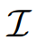
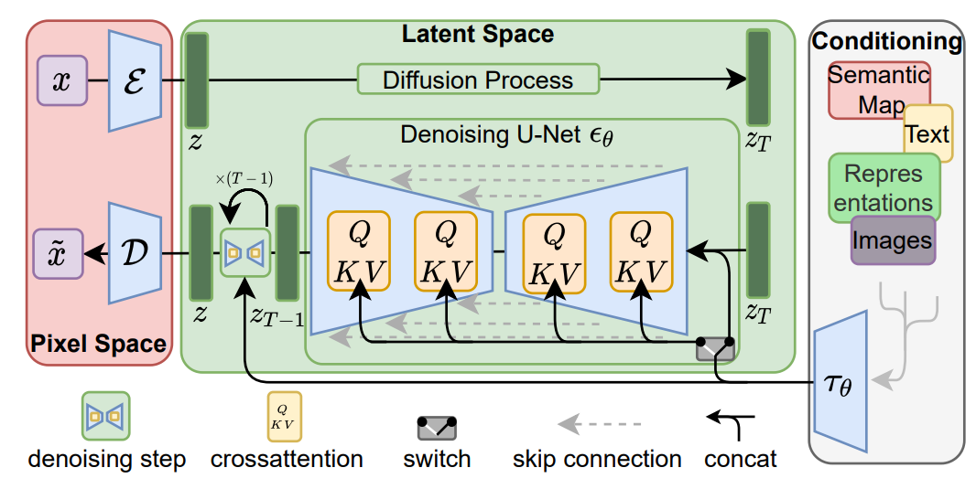
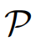
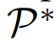
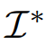
Main Idea
Text-to-Image diffusion models input text information through cross-attention layer
appearances of the generated image depend not only on the random seed, but also on the interaction between the pixels to the text embedding
→ pixel-to-text interaction occurs in cross-attention layer
→ Injecting the cross-attention maps of the input image enables us to preserve the original composition and structure.
Denoising process
Noise
Attention map
Pixel-text interaction
Noise
Denoising process
Latent diffusion architecture

Slide 5
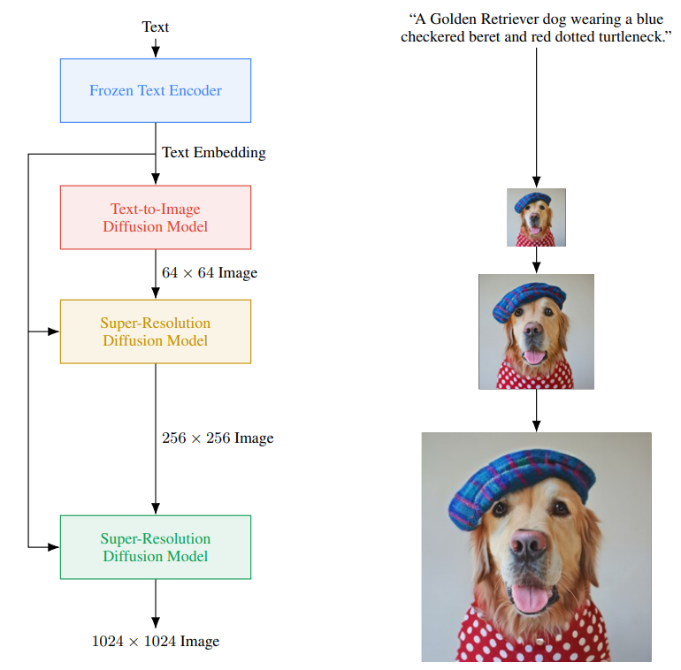
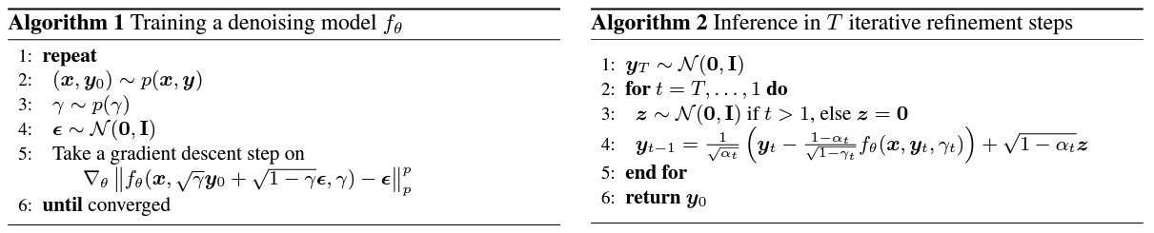
Based on Imagen
Imagen
Text-to-image diffusion models using pretrained LLM
→LLM can give semantic text information
Classifier-free guidance → conditioning generation
+ Super-Resolution Diffusion model → details↑

Slide 6
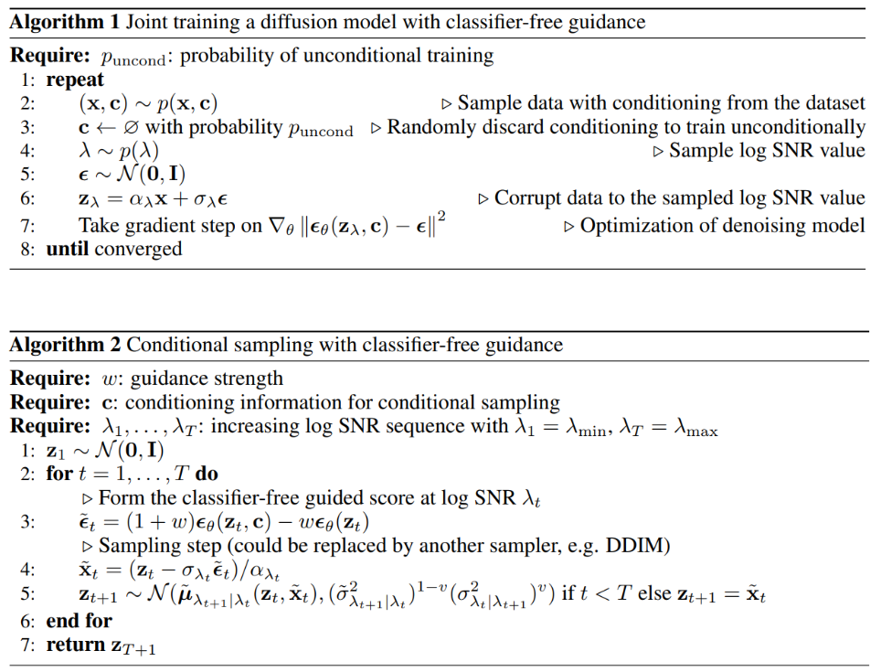
Classifier free guidance
Not using pre-trained classifier
→ pre-trained classifier: more memory
Need to be trained in the time steps
Diversity↓(~GAN)
Train the model in cond + uncond(~10%)
Sampling the noise
why didn’t they use only conditional noise?
→ c can have diverse images
→ conditioning↓
So minus unconditional noise → conditioning↑+ controllable (maybe…)
uncond

Slide 7
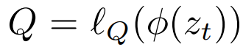
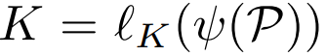
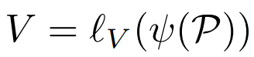
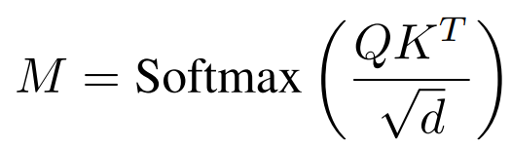
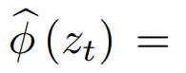
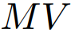
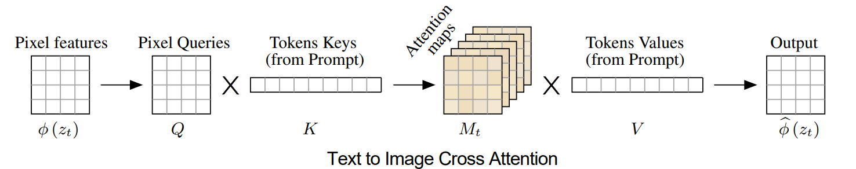
Cross-attention layer
In diffusion models, Cross-attention layer can input the text information
Image features of pixels
Tokens form prompt
cross-attention output
→ used to update the spatial features
Attention map → similarity btw Q and K

Slide 8
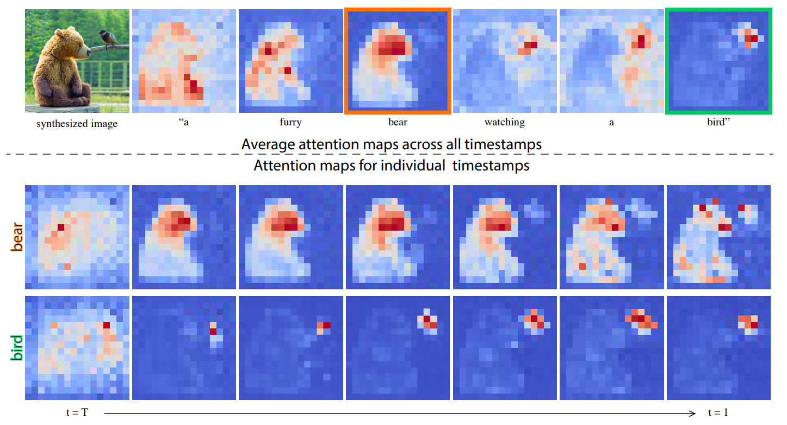
Attention maps
In cross attention layer & hybrid attention layer(self + cross), cross attention maps are related in spatial layout and geometry of the generated image
So, injecting the attention maps obtained from the generation with original prompt into another generation process with different prompt → preserves the structure of the first image

Slide 9
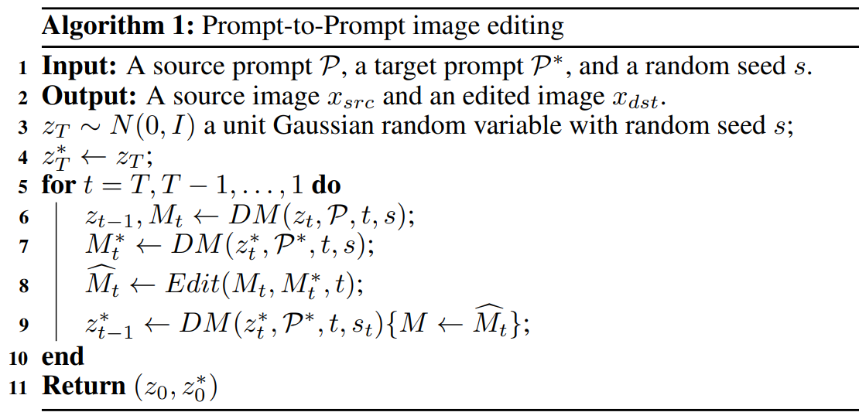
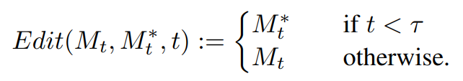
Algorithm
Image, attention maps with prompt $P$
Exploit attention maps with prompt $P^{∗}$ (don’t use images)
Change the attention maps
Generate images with changed attention maps & prompt $P^{∗}$
Edit the attention maps according to task

Slide 10
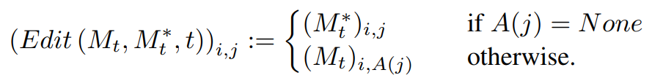
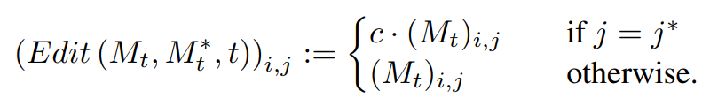
Editing attention maps
Word Swap
Adding a New Phrase
Attention Re–weighting
Injecting attention maps of source image before the certain time steps →allowing the necessary geometry freedom
→ New tokens
→ tokens wanted to strengthen or weakens

Slide 11
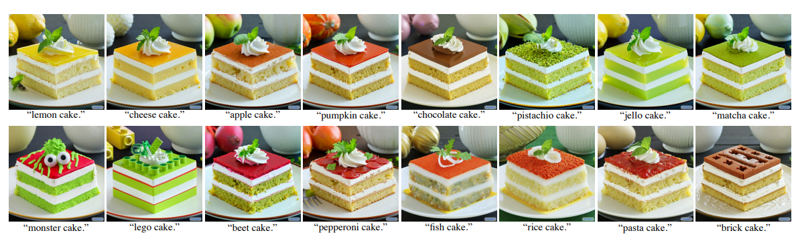
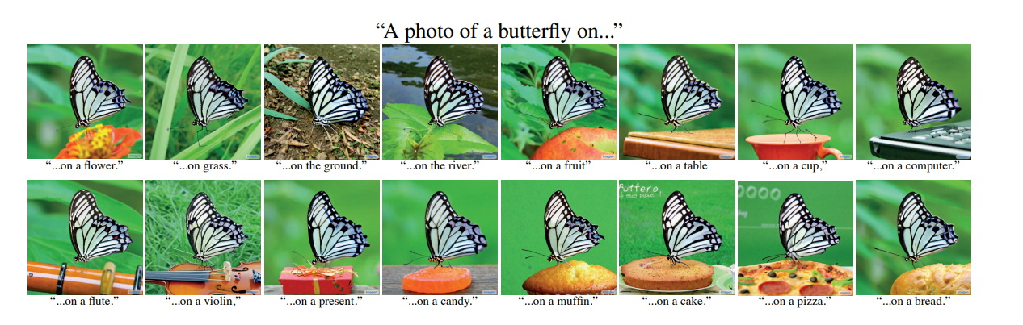
Result
Injecting only the
attention weights
of the word “butterfly”

Slide 12
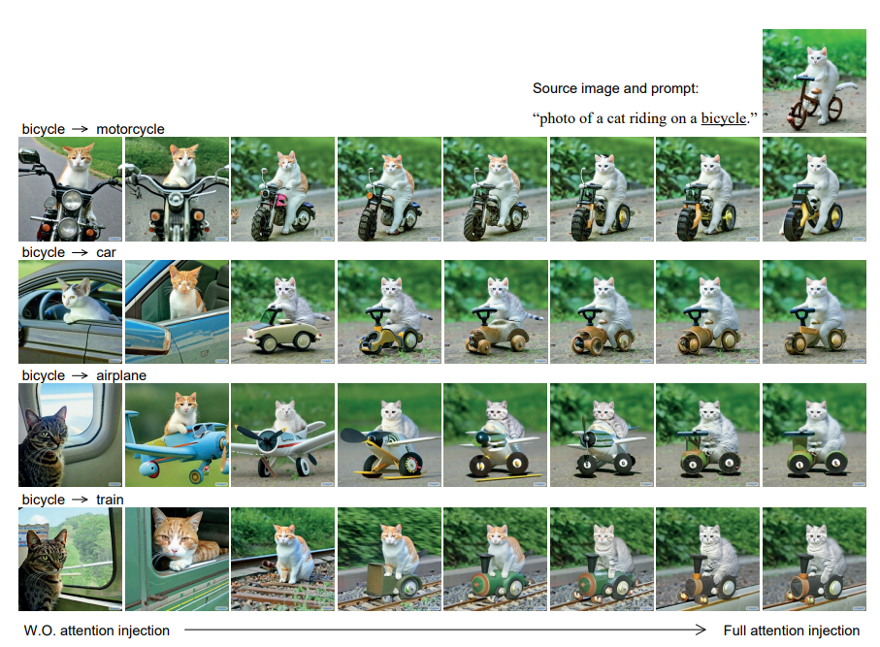
Result
Injecting the cross-attention maps 0%~100% of diffusion steps
→ fidelity to the original image↑
But 100% is not the best

Slide 13
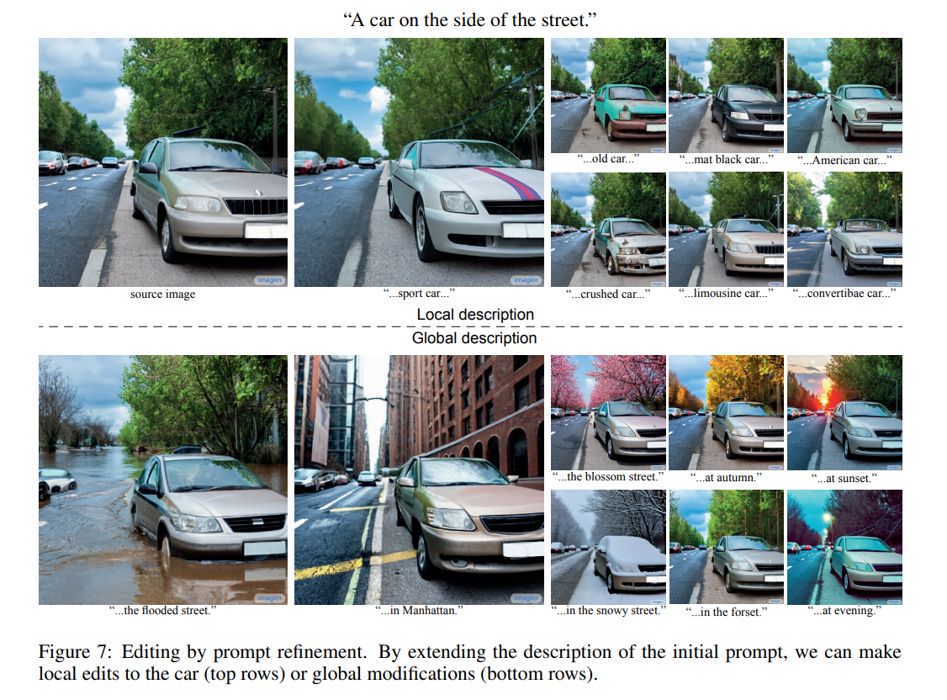
Result

Slide 14
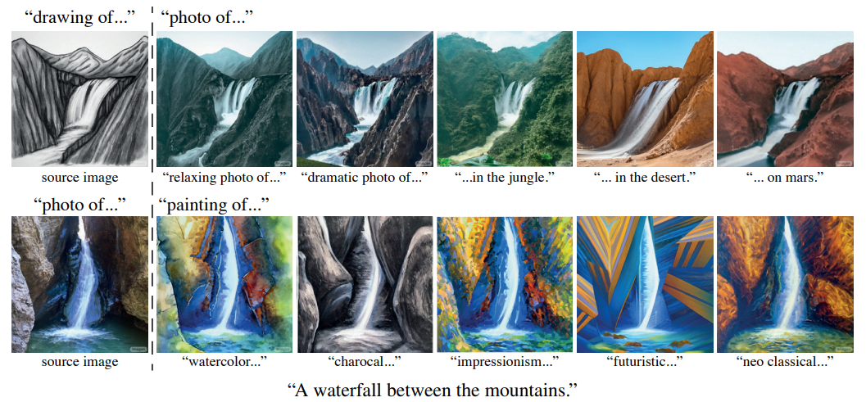
Result
Global editing is available

Slide 15
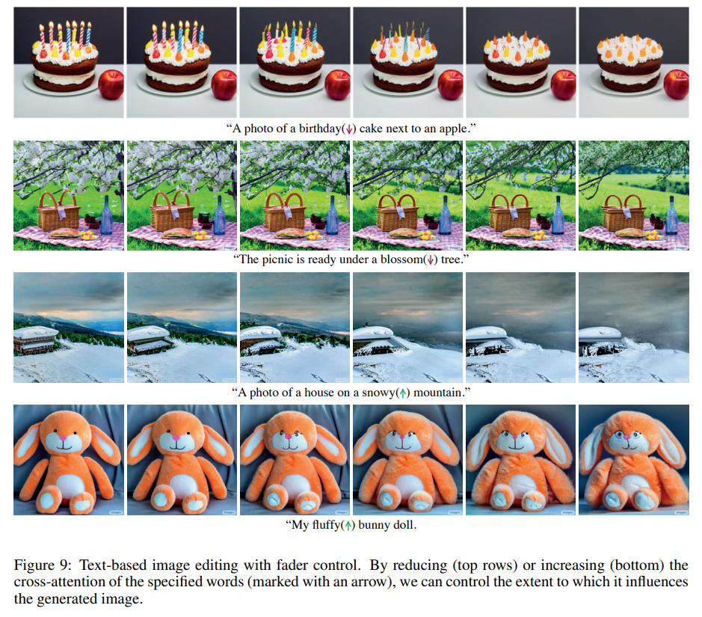
Result
Control the attention mask
→ influence ↑

Slide 16
Real Image Editing
Can’t directly input the real image → we need inversion

Slide 17
Strength & Limitation
Strength
Uncovered powerful capabilities of the cross-attention layers
easy editing by another prompt without any masks
Limitation
Can’t perfectly edit real images
→ model just edit the image generated by this diffusion model

